Slide 1

Girls on Board
An approach to help schools help girls (aged 7 to 18) navigate the choppy waters of friendship problems.

Slide 2

Girls are no problem, no problem at all…
On the whole, girls want to get on with everyone and be happy. However, they sometimes find that the search for trusting and reliable friendships is hard and that without such friendships they feel very unhappy. Their unhappiness is often displayed through tearfulness and even depression. Adults can help in only very limited ways because the problems within friendship groups are very fluid and difficult to express precisely.

Slide 3
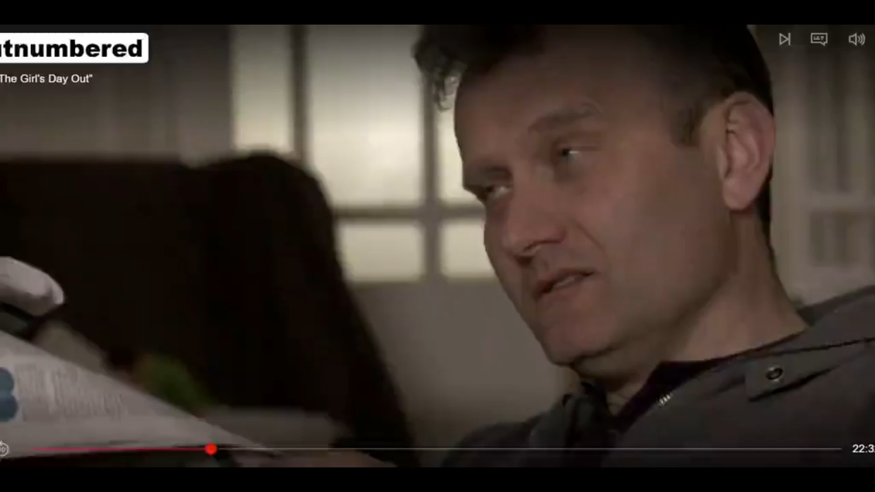
https://www.youtube.com/watch?v=jMdOzwnqpLU

Slide 4
THE most important thing is:
EVERY GIRL NEEDS A FRIEND
Is it not true to say that every girl, between the age of 8 and 18, needs another girl, in their school, in their year group, to call a ‘friend’?

Slide 5
Pairs
Threes
Fours
Fives?
What are the advantages and disadvantages?
Group sizes:

Slide 6
Types of Girl Behaviour
Queen Bees
Messengers
Lonely Girl
Would be Leaders
Peacemaker
Hopper
Girl-in-the-water
(Use this information wisely – it describes behaviour not girls.)

Slide 7
Corridor Test
Where would you put yourself? Front, middle or back?

Slide 8
Role Play
Three friends:
Audrey, Ethel and Doris

Slide 9
Managing parents
We KNOW why girls lie to their parents; they don't want to get told off. But there are consequences
No one likes the sympathetic listener to offer solutions, so parents should listen and be nice.
Who talks to the pet, instead?

Slide 10
Role Play
Four friends:
Audrey, Ethel, Doris and Clementine

Slide 11
Summary
Most girls reckon it gets worse, not better, when grown ups try to get involved in friendship issues. The Girls on Board approach helps you – the girls – to sort the problems for yourselves.
When friendships get a bit turbulent, the school will call and session, like this one, to reflect back to you all the stuff we have talked about today.

